Slide 1

Reducing Customer Churn to Protect Revenue
Executive dashboard for retention insights
Analysis period : Full Customer Lifecycle Dataset.
Report generated: January 2026.
Audience: Executive Leadership, Revenue and Retention, Product Strategy.

Slide 2

Measurement Framework: Churn Analytics and Retention Health
Integrated dashboard tracking lifecycle risk signals and retention effectiveness
Customer Demographics
Geographic Performance
Age, gender, and lifecycle stage
segmentation to identify vulnerable profiles
Regional churn rates and state concentration to guide localized action
Service Utilization and Value
Adoption rates, bundle penetration and add-on engagement measuring perceived value
Contract and Tenure Dynamics
Contract types and tenure cohorts to flag high-risk segments for intervention
Payment and Billing Experience
Payment method adoption and billing friction indicators exposing retention barriers

Slide 3

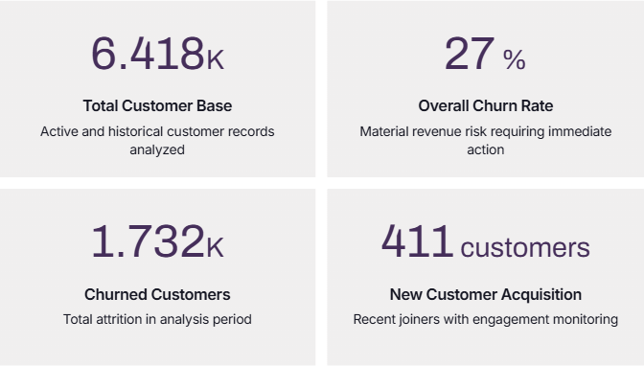
Dashboard Insights: Current Performance vs Churn and Retention
Snapshot of customer health and immediate retention risk

Slide 4
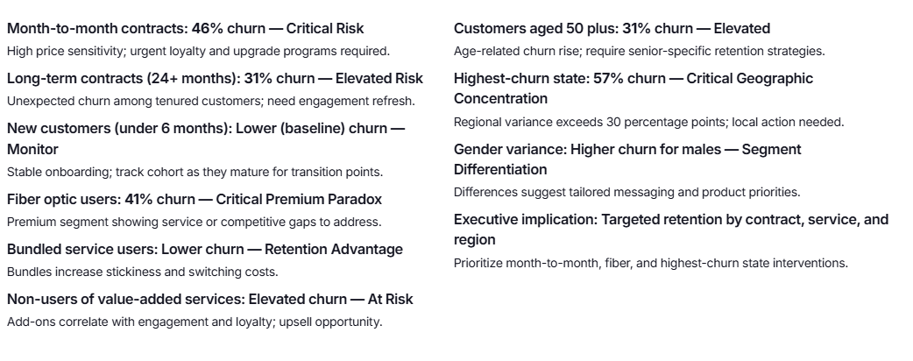
Operational Excellence: Churn Drivers and Segment Performance
Data-driven risks and retention levers across contracts, services, and demographics

Slide 5









Financial Impact: 27% Churn Revenue Risk and Retention ROI
Revenue preservation levers and near-term priorities
27% churn equals 1,732 lost customers
High CAC recovery risk from continuous acquisition
Lifetime value compressed by churn
Month-to-month upgrade opportunity (46% segment)
Fiber quality improvement: reduce churn from 41% toward 20-25%
Direct recurring revenue loss from attrition
27% churn forces ongoing spend, reducing margins
Shorter tenure limits cross-sell and upsell upside
Convert to longer commitments to improve CAC payback
Retain ~300 customers annually; preserve premium revenue
Increase value-added service adoption
Targeted geographic campaigns for 57% high-risk state
Drive digital payment adoption
Business case: improving churn 27% to 20%
Reduce operational costs and involuntary churn
Retain ~476 customers annually; preserve recurring revenue
Higher ARPU, stronger retention through bundles
Local interventions to stop concentrated revenue leakage

Slide 6




Strategic Alignment: Churn Reduction Goals and Competitive Positioning
Maximize Customer Lifetime Value: reduce churn from 27% to 20%
Extend tenure by 40%; increase tenure by 8+ months; improve LTV:CAC payback
Clear targets, regional focus, and service-led differentiation
Strengthen competitive moat through service excellence
Cut fiber churn from 41% to 25%; raise bundle adoption by 30%; lower competition-driven churn by 40%
Optimize geographic market performance
Reduce highest-state churn from 57% to 30%; cut geographic variance spread by 50%
Performance tracking and accountability
Monthly dashboard: churn, segment performance, geographic variance for course correction

Slide 7
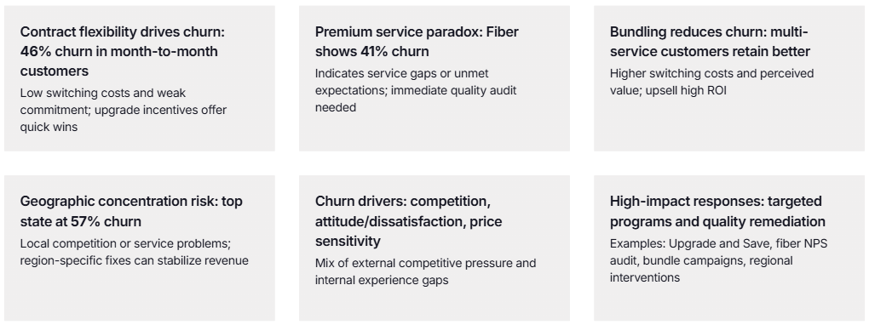
Critical Insights: Root Causes and Strategic Opportunities in Churn Data
Data-driven levers to reduce churn and protect revenue

Slide 8
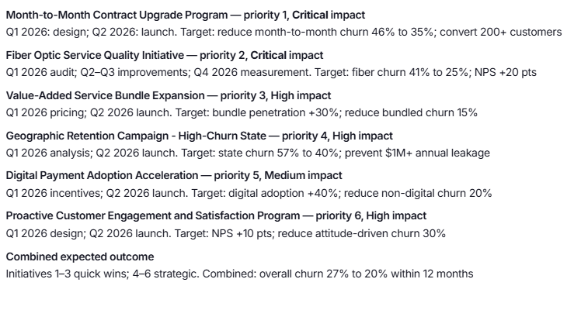
Execution Roadmap: Prioritized Retention Initiatives and Timeline
Six initiatives sequenced for rapid wins and sustained churn reduction by Q4 2026

Slide 9
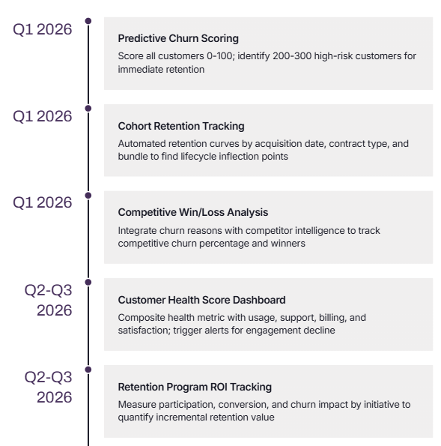
Dashboard Evolution: Enhanced Analytics for Proactive Decision-Making
Roadmap of analytics milestones and business impact, Q1 2026 to Q4 2026+

Slide 10
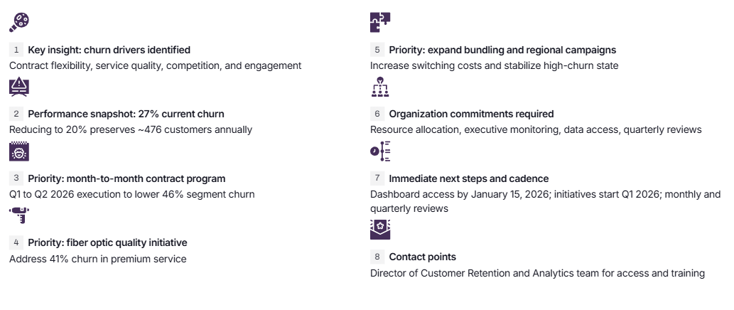
Moving Forward: Data-Driven Retention Strategy & Organizational Commitment

